Slide 1

Copyright (c) 2024
cyradotpink

Slide 2
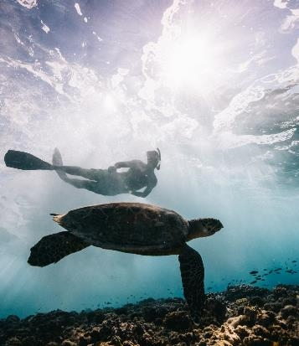


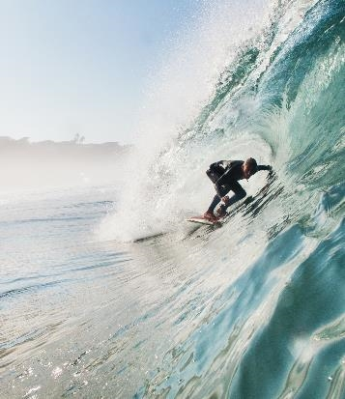
Permission
is hereby granted, free of charge, to any person obtaining a copy of this software and associated documentation files (the "Software"), to deal in the Software without restriction, including without limitation the rights

Slide 3



to use,
copy, modify, merge, publish, distribute, sublicense, and/or sell copies of the Software, and to permit persons to whom the Software is furnished to do so, subject to the following conditions:

Slide 4

The above copyright notice
and this permission notice shall be included in all

Slide 5

copies or substantial portions of the Software.
THE SOFTWARE IS PROVIDED "AS IS",

Slide 6




WITHOUT WARRANTY OF ANY KIND,
EXPRESS OR
IMPLIED,
INCLUDING
BUT NOT
LIMITED TO
THE WARRANTIES
OF
MERCHANTABILITY,

Slide 7

FITNESS
FOR A PARTICULAR PURPOSE AND NONINFRINGEMENT. IN NO EVENT SHALL THE AUTHORS OR COPYRIGHT HOLDERS BE LIABLE FOR ANY CLAIM, DAMAGES OR OTHER LIABILITY, WHETHER IN AN ACTION OF CONTRACT, TORT OR OTHERWISE, ARISING FROM,

Slide 8

OUT OF OR IN CONNECTION
WITH THE SOFTWARE
OR THE USE OR OTHER
DEALINGS IN THE SOFTWARE.

